Slide 1

Introduction to Log File Analysis
By Zach Mewshaw

Slide 2

Objectives:
Understand what log files are on Windows and Linux operating systems.
Understand the basics of analyzing log files in Linux command line and PowerShell.
Understand the basics of scripting in Bash to aid in our analysis.
Notes:
So just to give you guys a clear understanding of what exactly we’re going to be doing today, we’ll start off with an overview of log files in general and go through their uses in Windows and Linux operating systems.
We’ll then go into how we can analyze them within their respective operating systems.
And finally, I’m going to give you guys an introduction to scripting in Bash and PowerShell to help with our analysis.
So hopefully at then end of this you guys will be able to have a solid understanding of how to approach most log file analysis problems whether it be in competitions or in the real world.

Slide 3


Introduction
“A log file is a file that records either events that occur in an operating system or other software runs, or messages between different users of a communication software.” (Wikipedia).
Logs vs network traffic
Used by:
Cybersecurity Analysts
System Administrators
Penetration Testers
The list goes on

Slide 4
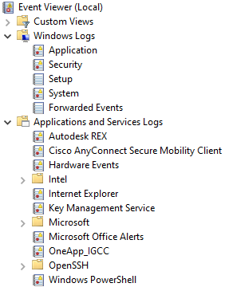
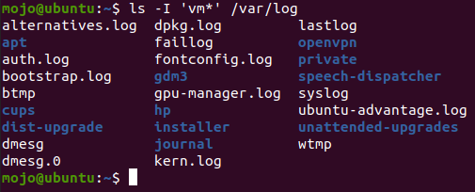
Introduction
Windows: Event Viewer
Linux: /var/log

Slide 5

Linux
Linux stores all log files in the directory /var/log.
Seen far more often in CTF’s than Windows logs as most servers run on Linux.
Important files:
auth.log – Authorization and security related events
kern.log – Kernel messages
syslog – Everything

Slide 6
Linux
We can analyze log files in Linux directly in the command line with text processing commands:
cat – Print the file
awk – Show only the nth column in a text file
cut – Remove sections
sort – Sort lines
uniq – Omit repeated lines grep – Print lines that match a pattern
wc – Print counts tr – Translate or delete characters
less – Displays text in pages
Piping allows us to chain these commands together!

Slide 7
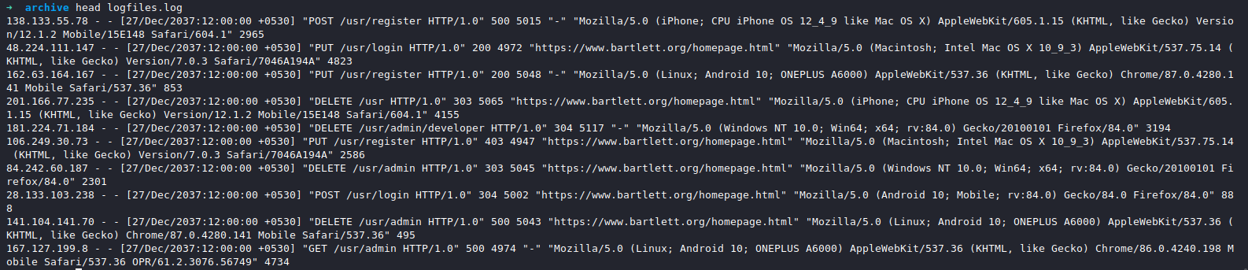
Linux
Example randomly generated Apache web server log
Output the file
Show only the first column
Sort the data
Remove unique entries
Count the lines

Slide 8

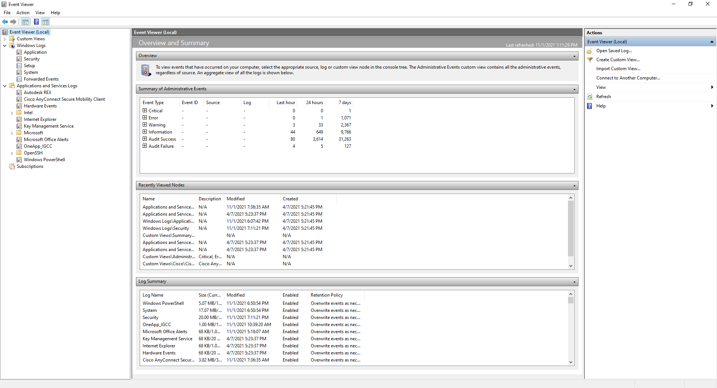
Windows Event Viewer (Vista+)
Location: C:\Windows\System32\winevt\Logs
Extension: .evtx
Categories:
Windows Logs
Applications and Services Logs
Extras
Notes:
Note: Event Viewer exists for previous versions of Windows, it’s just that these details are not accurate.

Slide 9
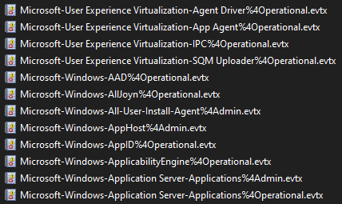
Windows Event Viewer (Vista+)
Event Viewer
File Explorer

Slide 10

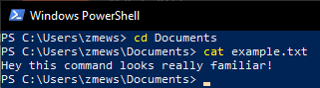
PowerShell
PowerShell is object oriented.
Many Linux commands work by default!
cat
cd
ls
man
ping
ssh
And more!

Slide 11
PowerShell
Windows logs can be queried in PowerShell using the command:
Get-WinEvent
Some tags we can combine with Get-WinEvent:
-ListLog • -ListProvider
-LogName • -Path
Additional PowerShell functions and tags we can use to manipulate data:
Sort-Object • Where-Object
Measure-Object • -Property

Slide 12
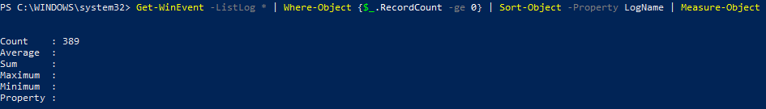
PowerShell

Slide 13


Bash Scripting
A must learn for anyone looking to pursue cybersecurity professionally
A command interpreter AND a programming language.

Slide 14

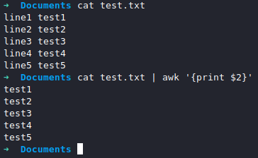

Bash Scripting
Commands can be invoked just as if it were the command line.
All files start with a “Shebang”: #!/bin/bash.
Used to specify the interpreter path (/bin/bash).
$0-$9 are reserved for arguments. Remember awk?

Slide 15

Bash Scripting
Variables are declared normally but called with $
Note: $ is not used with making an assignment i.e., x+=4
Sequences are built with curly brackets {} separated by 2 periods.
Strings, integers, files, and Booleans all have different comparison operators i.e., ==, -eq, -e, && respectively.

Slide 16

Bash Scripting
double parentheses is used to specify arithmetic (())
Syntax of loops for loops:
for $variable in 1 2 3 4 for $variable in file1 file2 file3
do do
echo $variable echo $variable
done done

Slide 17
Bash Scripting
double parentheses is used to specify arithmetic (())
Syntax of loops for loops:
for variable in 1 2 3 4 for variable in file1 file2 file3
do do
echo $variable echo $variable
done done

Slide 18

Live Demo

Slide 19
Useful Resources
Linux Text Processing: https://tldp.org/LDP/abs/html/textproc.html
Fake Apache Log Generator: https://github.com/kiritbasu/Fake-Apache-Log-Generator
Microsoft's own documentation for PowerShell is pretty solid.

Slide 20



Proud Sponsors

